Slide 1
# 15 Trash Sorter
Final demo
18-844 project final
Kejia Hu, Bowei Li, Zijia Liu

Slide 2
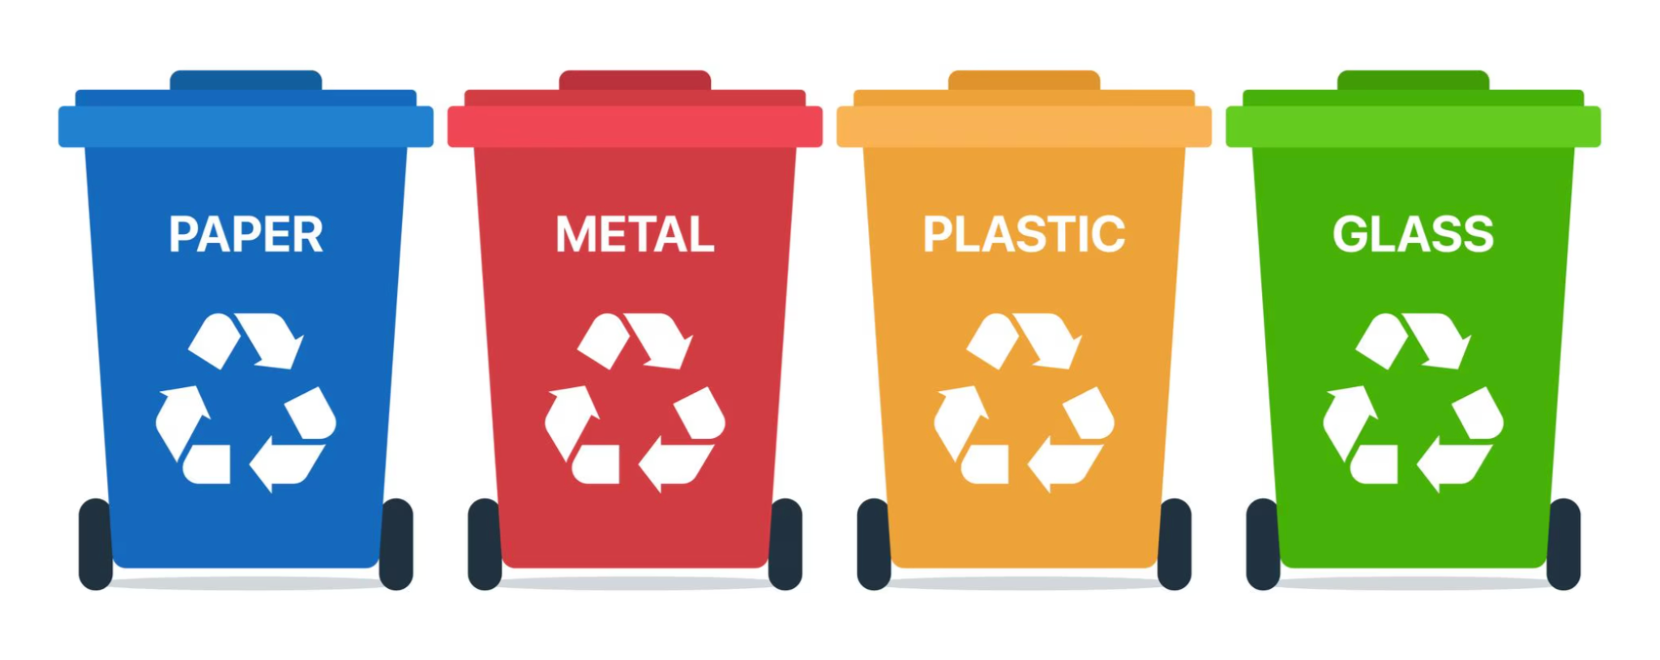
Abstract
objectives and motivation:
a smart device that helps people put trash in the right bin
target users:
General public using public recycle bins
Organizations running sustainability or recycling programs
People who have difficulty manually sorting trash
Click to Edit Presentation Title
Click to edit Presenter Name
Presenter Title
Notes:
Main title: 40 pt. Arial
Presenter Name: 16 pt. Arial
Presenters Title: 16 pt. Arial Italic

Slide 3
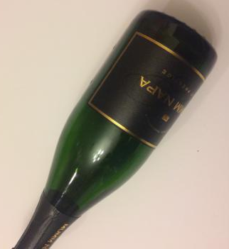
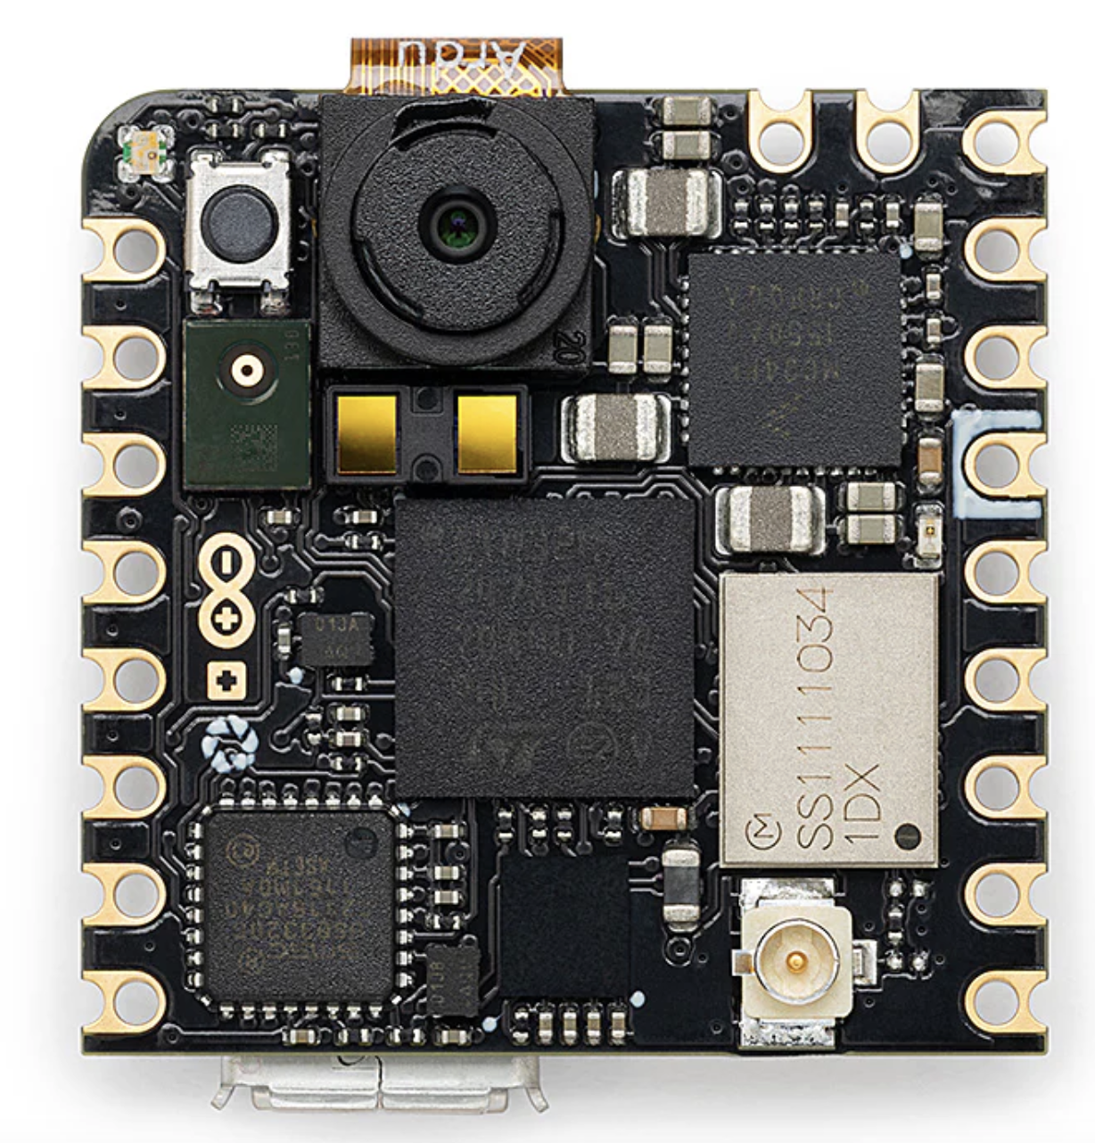
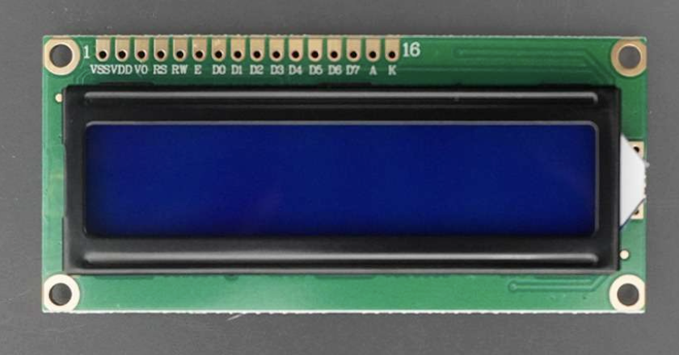
Introduction
a smart device that helps people put trash in the right bin
trash
Nicla Vision
LCD
Notes:
We want to develop a smart trash classification device to make waste management more efficient and environmentally friendly. By automatically identifying and sorting trash into categories like recyclables, organic waste, and non-recyclables, the device helps reduce human error, saves time, and increases recycling rates. It also encourages sustainable habits and supports cleaner communities by ensuring waste is disposed of correctly.
Nicla Vision combines a powerful STM32H747AII6 Dual ARM® Cortex® M7/M4 IC processor with a 2MP color camera that supports TinyML, as well as a smart 6-axis motion sensor, integrated microphone and distance sensor.

Slide 4
Why use Embedded ML?
Bandwidth: eliminate heavy upstream data transmission, conserve bandwidth
Latency: inference locally at MCU, achieve low latency
Economics: reduce recurring costs by eliminating dependence on cloud servers
Reliability: local processing ensures continuous operation even during network outages
Privacy: prevents personal image data from leaving the device

Slide 5
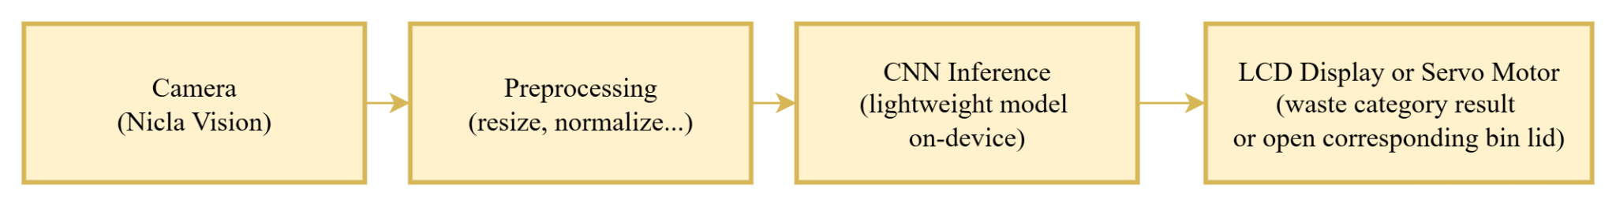
Overall block diagram
I2C

Slide 6
Methods - data collection
Kaggle Baseline: Started with the public Kaggle Garbage Classification dataset as the initial training source.
Manual Cleaning: Manually removed blurry, mislabeled, and ambiguous images to fix quality issues found in the original dataset.
Real-World Capture: Collected new images using the actual Nicla Vision camera to ensure the data matched the specific hardware and lighting of the deployment environment.
Standardization: Resized all images to 96x96 RGB pixels and split them into training and validation sets for Edge Impulse.

Slide 7
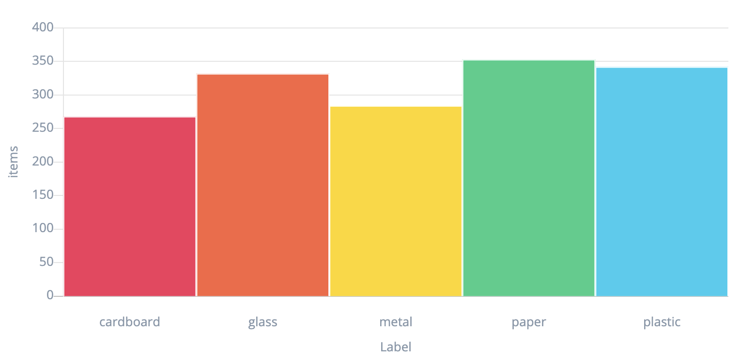
Dataset distribution

Slide 8
Methods - ML models
Model Architecture Utilized MobileNet V2 (0.35 alpha), selected for its superior balance of speed and accuracy on embedded devices compared to EfficientNet.
Optimization Strategy Applied INT8 Quantization to compress the model for the STM32H7 MCU, achieving an ultra-low inference latency of ~97ms.
Training Pipeline Input images are resized to 96x96 RGB and processed using Transfer Learning based on pre-trained ImageNet weights.
Final Performance The deployed quantized model achieved a 74.17% test accuracy, successfully meeting the project's real-time classification goals.

Slide 9
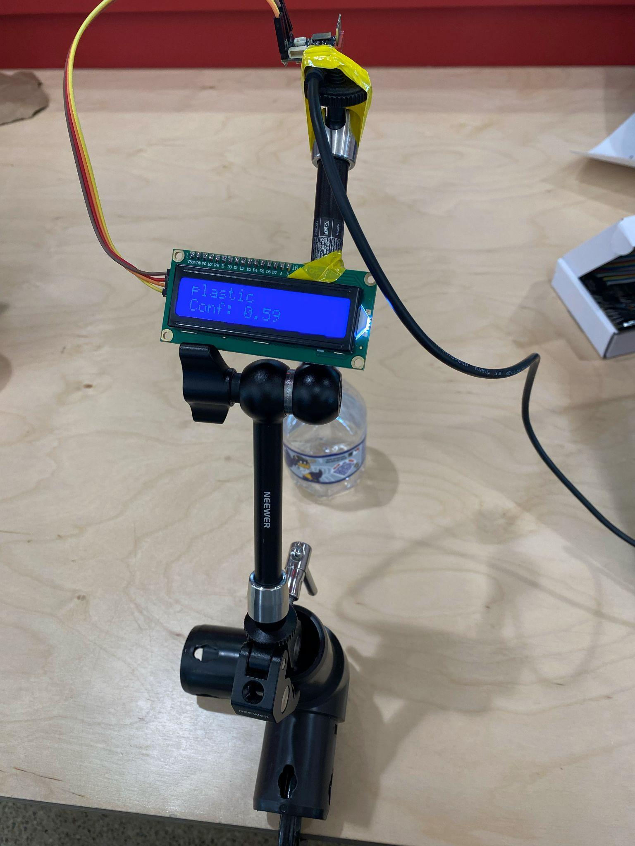
Methods - embedded systems implementations
The Nicla Vision captures an RGB image of the waste item using its onboard camera every one second and performs on-device inference using a lightweight convolutional neural network deployed through the Arduino IDE. For each frame, the model outputs a predicted waste class along with a confidence score.
After inference, the Nicla Vision communicates the result to an external LCD module over the I²C bus. The predicted class label and its associated confidence value are displayed in real time.

Slide 10
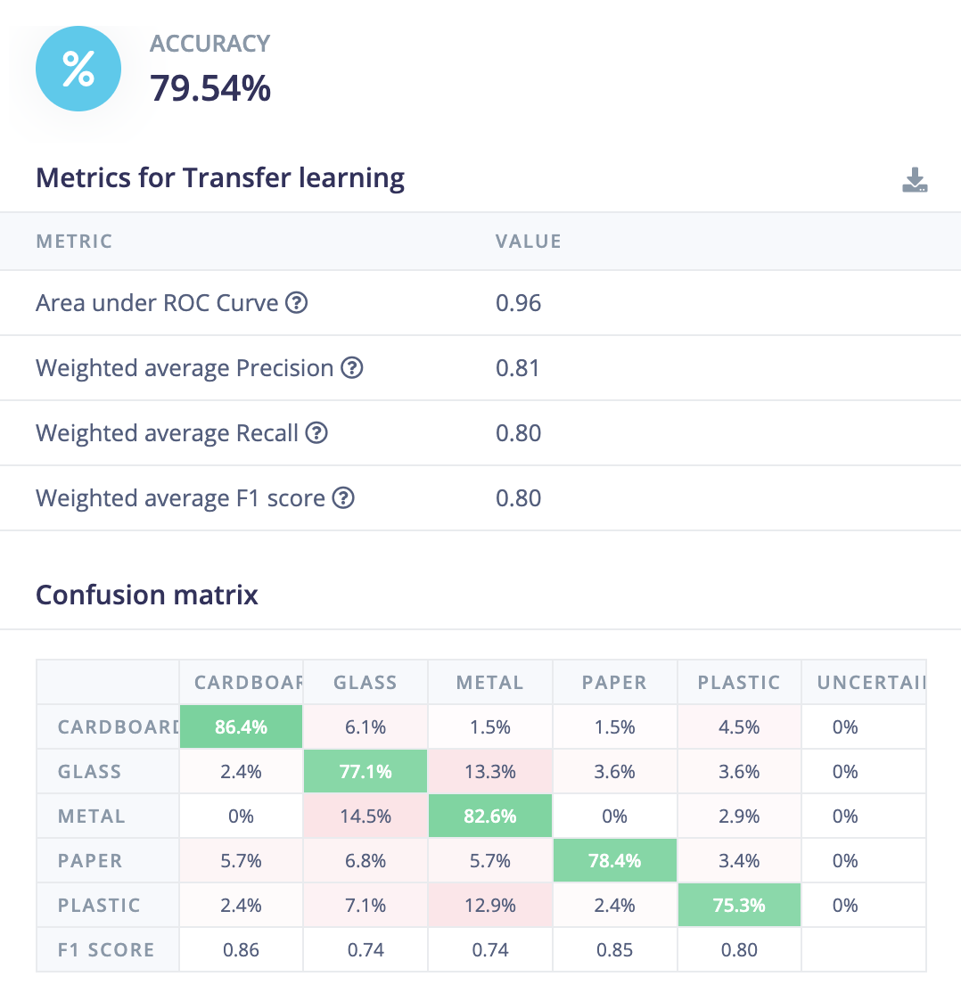
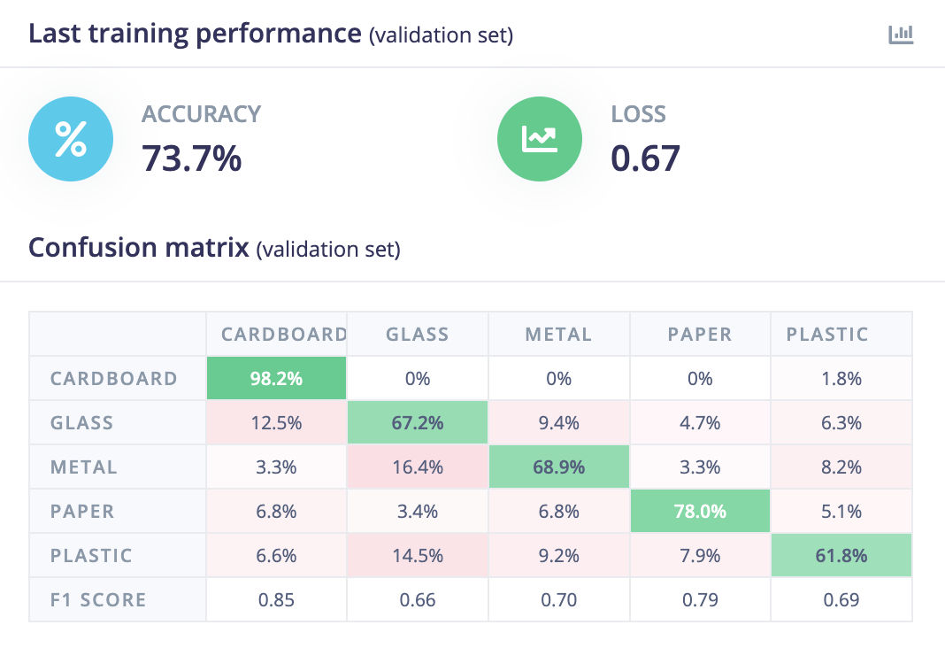
Results
Validation accuracy
Testing accuracy

Slide 11
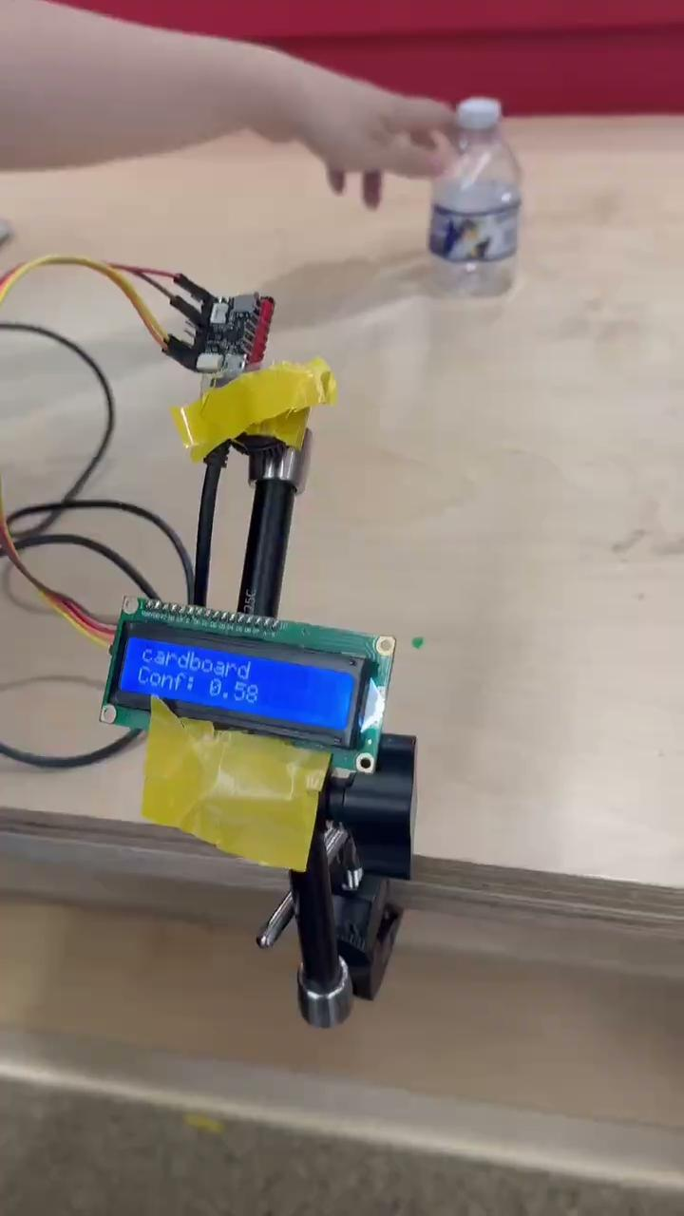
Video

Slide 12
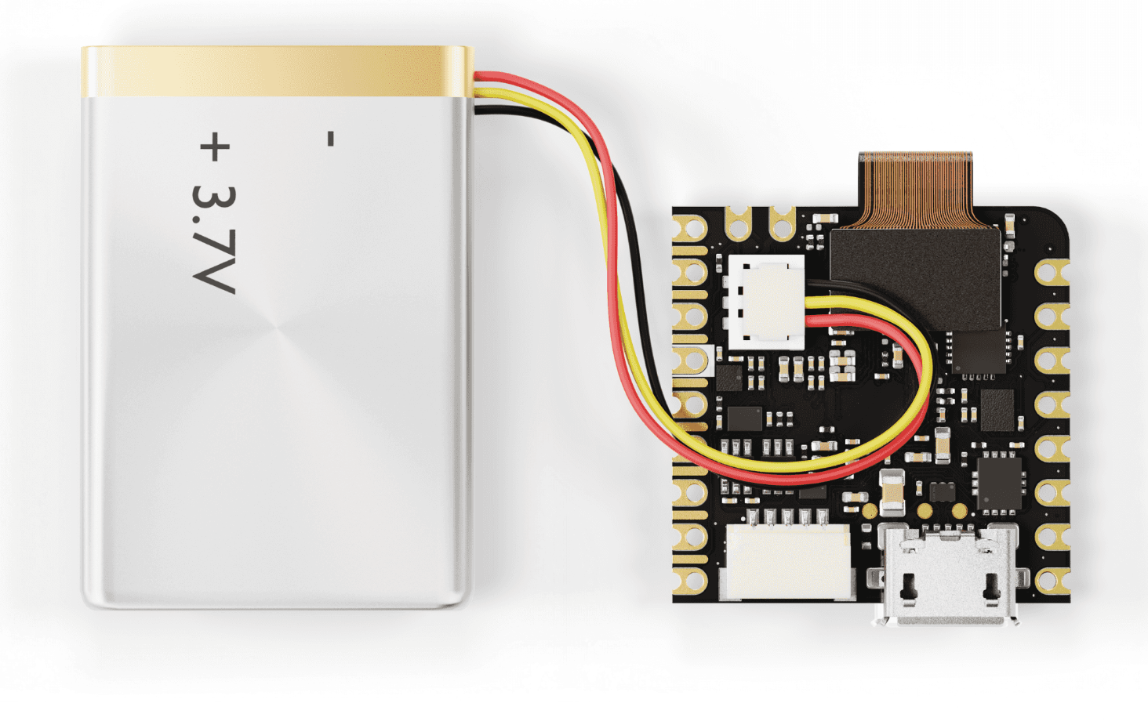
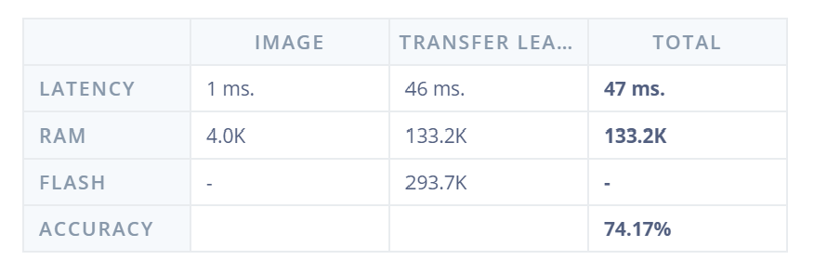
Challenges - Power Consumption
Device Operating Mode
Camera + Inference Model: 250–350 mW
Based on a 3.7V Li-Po battery, this corresponds to: → 70–95 mA (full-speed inference)
Display Module
LCD consumption: 20–25 mA
Total System Current
→ ≈ 90–120 mA during continuous inference
With a typical 5000 mAh Li-Po battery, our system (camera + inference + LCD) can run for approximately 2-3 days of continuous operation.

Slide 13
Challenges - Power Consumption
Power Saving with Event-Triggered Inference
Instead of running inference continuously, the device can only activate the camera and model when a button press is detected.
For the rest of the time, it stays in a low-power mode (< 50 mW, ~10–15 mA).
This reduces the average current from about 90–120 mA to roughly 15–25 mA,
leading to a 5–10× increase in battery life.
Example:
Continuous inference → 5000 mAh ≈ 2 - 3 days
Event-triggered inference → the same 5000 mAh can last for several weeks.
Or simply install a power outlet nearby and plug the device in directly.

Slide 14
Challenges - Class limitation
One limitation of our system is that it can only classify items belonging to a small set of recyclable categories: cardboard, glass, metal, paper, and plastic. Real-world waste includes many additional types—such as food waste, textiles, electronics, compostable materials, or hazardous waste—that our model is not trained to recognize. As a result, the device may fail to provide useful guidance when users present items outside the supported categories.

Slide 15
Thank you !

